Slide 1


Titanic Data Exploration: Finding Stories Behind the Numbers
Welcome to a journey through data that reveals the human stories behind one of history's most famous maritime disasters. In this presentation, we'll explore the relationship between passenger titles and their survival chances, uncovering how social structures manifested during this tragic event.
Join me as we dive beneath the surface of numbers to find meaningful narratives that connect data science with human experience.
by ohsama

Slide 2




Project Background
Understanding the Dataset
Handling Data Issues
This project was created as a final assignment for Digital Fair Skill, a 5-day mini course introducing practical Data Science.
The core tasks involved understanding dataset contents, managing duplicate data, and addressing missing values.
Going Deeper
Beyond the basic requirements, I chose to dig deeper—extracting insights from the passenger "title" attribute to reveal hidden patterns.

Slide 3
Data Cleaning and Preparation
Missing Values in 'Age'
Duplicate Data
To address missing age values, I created a new 'title' column extracted from passenger names. Titles often reflect age ranges (e.g., Master for children, Mr/Mrs for adults).
One duplicate row was identified and removed to maintain data integrity.
This cleaning process wasn't just about tidying data—it was about establishing a foundation for meaningful analysis.
I calculated the median age for each title group, then used these values to fill missing age data based on passenger titles.

Slide 4

Title: A Hidden Treasure in the Data
Age Indicator
Marital Status Indicator
'Master' typically used for young boys. 'Miss' and 'Mrs' for females, with 'Mrs' indicating married status and generally older than 'Miss'.
Titles provide insights about dependents, partners, or social position, offering context beyond raw demographic data.
Social Status & Profession
Titles like Dr, Rev, Col indicate education level or respected positions, potentially influencing evacuation priority during emergency.

Slide 5
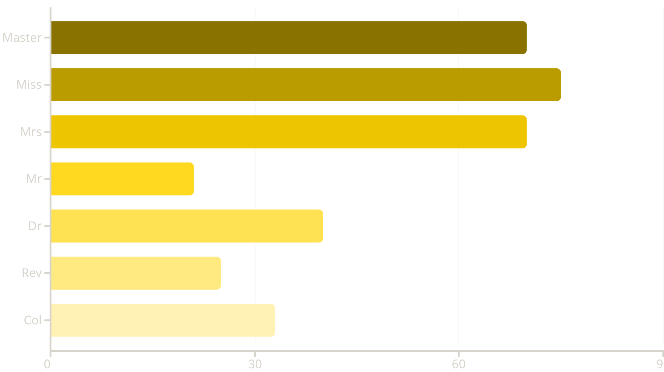
Does Title Affect Survival?
I was curious: Did certain titles increase survival chances? Would passengers with honorable titles like Dr, Col, or Sir receive priority during evacuation?
The results are clear: Children and women had significantly higher survival rates. Master (boys) showed ~70%+ survival, while Miss & Mrs (women) achieved ~70-75% despite their large numbers. Adult men (Mr) had only ~21% survival rate.
Prestigious titles like Dr, Rev, and Col didn't guarantee safety, suggesting evacuation likely followed the "women and children first" principle rather than social status alone.

Slide 6








Conclusion & Takeaways
Hidden Insights
Critical Thinking
Simple features like 'title' can contain invaluable insights that transform our understanding
Data cleaning isn't just about tidying—it's a critical thinking process
Storytelling
Human Context
Behind every number and graph lies a story—our job as Data Scientists is to help that story be heard
This exploration combines data science with social understanding for more human-centered analysis

